Slide 1
Anomaly Detection in Bipartite Networks
Mohammed Eslami, Ph.D
George Zheng, Hamed Eramian, Georgiy Levchuk

Slide 2
Disclaimers
This research was developed with funding from the Defense Advanced Research Projects Agency (DARPA).
The views, opinions and/or findings expressed are those of the author and should not be interpreted as representing the official views or policies of the Department of Defense or the U.S. Government.

Slide 3
Outline
Goal: Formulate cyber logs as bipartite graphs and an an analytical workflow that use graph features to highlight events of interest to a cyber analyst.
Overview of Network Defense
Cyber Data Represented as Bipartite Graphs
Graph Analytical Components, Features, and Workflow for Cyber Security
Scalability and Examples
Conclusion/Next Steps

Slide 4
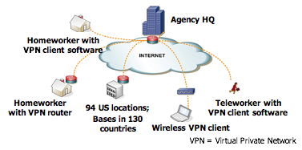
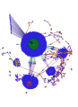
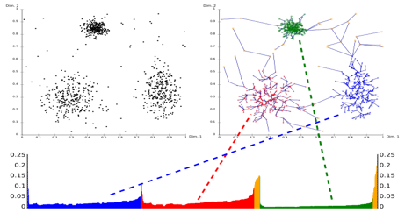
The Challenge of Network Defense
Rapid identification of network anomalies in billions of records across a heterogeneous logs.
Enterprise Netflow and log data:
12 billion events per day,
1 TB per day of communications
>60,000 employees,
>570,000 users
Moving beyond State of the Art:
Rule-based signatures → Adaptive behavior detection
Stateless single IP analyses → Context based decisions
Manual analysis → Guided automation
Clustering
Graphs
Sequence
Source: Deason, L. et. al. Scalable Temporal Analytics to Detect Automation and Coordination. Flocon 2017

Slide 5
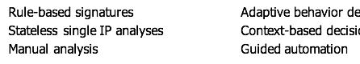
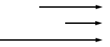
The Challenge of Network Defense
Rapid identification of network anomalies in billions of records across a heterogeneous logs.
Enterprise Netflow and log data:
12 billion events per day,
1 TB per day of communications
>60,000 employees,
>570,000 users
Moving beyond State of the Art:
Clustering
Graphs
Sequence
Source: Deason, L. et. al. Scalable Temporal Analytics to Detect Automation and Coordination. Flocon 2017

Slide 6

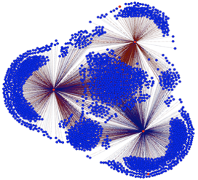


Types of Bipartite Graphs from Enterprise Networks
Bipartite graphs, graphs that have edges only between two distinct entity types, provide an opportunity to capture the relationships between entities within and across types but pose a unique set of challenges in their storage, scalable analysis, and interpretability.
IP-IP Graphs
Client-Server Graphs
User-Service Graph
User 1
SMB
User 2
Kerberos
User 3
DNS, HTTP, SMTP, etc. logs – edges only between client IP and server IP
RDP, SMB, Kerberos, etc. logs- edges only between users and services used
Netflow records – edges only between internal/external IPs

Slide 7

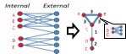
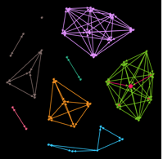
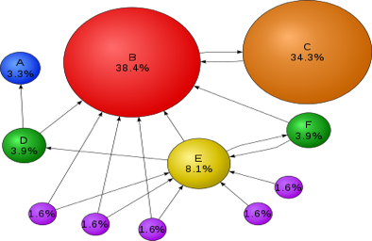
Bipartite Graph Analysis for Enterprise Scale Network Defense
Analytical suite infers relationships between similar entities, scales to billions of records, and provides rapid situational awareness to SOC analyst.
Data
Analytics
Analytical Contributions
...
A novel method to capture and represent similarity between network entities
A scalable method to compute directional graph projections for enterprise scale networks
A mapping between extracted graph features and relevant cyber use cases to an analyst
Sensor 1
Sensor N
Directional Graph Projections
Community Detection
Source: Page Rank. Wikipedia
First Order Graph Features

Slide 8
Analytics: Directional Graph Projections
Traditional Graph Projections
Directed Graph Projections
Nuances introduced by different graph weights and different destination nodes are ignored
Asymmetric similarity measure can capture difference in usage of uncommon servers between clients
Notes:
Break this up

Slide 9
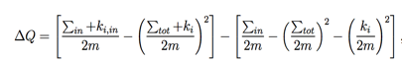
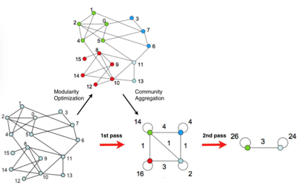
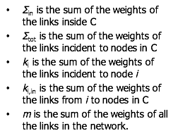
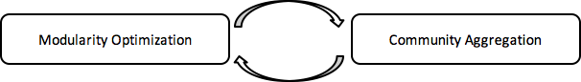
Analytics: Community Detection
Identify communities within a network that are more connected to each other than other parts of the network.
Reference: Blondel, V. et al. Fast unfolding of communities in large networks, 2008

Slide 10
Analytics: Interpretable First Order Graph Features
Graph Feature | Cyber Story
Raw Degree | # of requests made, # of services used, …
Raw Weighted Degree | Amount I’m using a specific service
Projected Degree | # of entities that I think I am similar to because we use a common service
Projected Community Size | # of entities I am actually similar to
Projected Page Rank | My “significance” as compared to other entities (ex. Admins will use more services than clients)

Slide 11
Cyber Use Case to Graph Feature Mapping
Data Type | Cyber Use Case Description | Features
User → Service | Infer user roles | Admins = High projected degree, community size, and page rank Non-admins = High projected degree but small community size and page-rank
Client → Server | Infer similarities between groups of clients | Typical Client Systems = High community size, projected degree, and low page rank
Internal IP → External IP | Identifying firewalls, VPNs, or other network access points from flow data | Firewalls = High raw degree, weighted degree, projected degree, community size, and page rank VPNs = High raw degree, weighted degree, projected degree, but small community size, and page rank

Slide 12
Graph Analytic Workflow
Modularization and integration identifies cyber use cases from graph feature mappings and also provides flexibility to identify anomalies within and across derived communities.
kNN Anomaly Detector
Anomalous Clients, Users, IPs
A
Identify communities in graph projection
Edge Pruning
C
B
Data
Create Bipartite Graph
Compute Directional Graph Projections
Cyber Use Case Scoring
Cyber Use case
Source: Page Rank. Wikipedia
Compute Page Rank

Slide 13
Scaling Directional Graph Projections
Message passing algorithms on graph data structure allows for custom asymmetric similarity measure and scales to O(e).

Slide 14
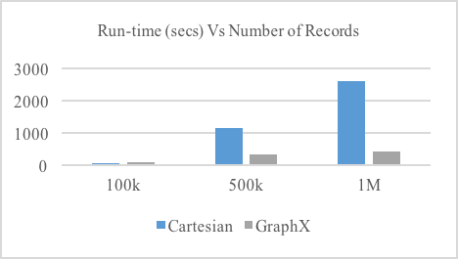
Technology Base
Graph Analytic Workflow
Breeze
10 executors
4GB driver memory
3GB executor memory
45x Dell servers, 17.28 TB RAM, and 2.304 PB HDFS Storage

Slide 15
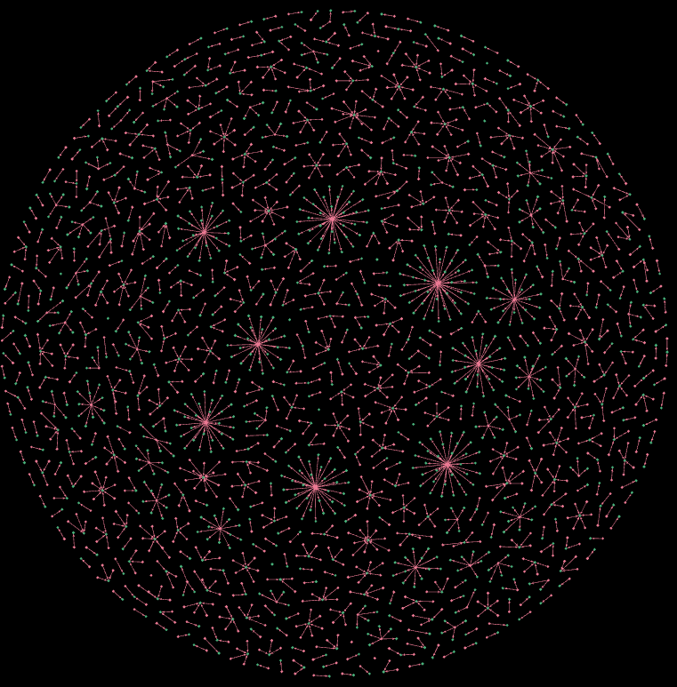
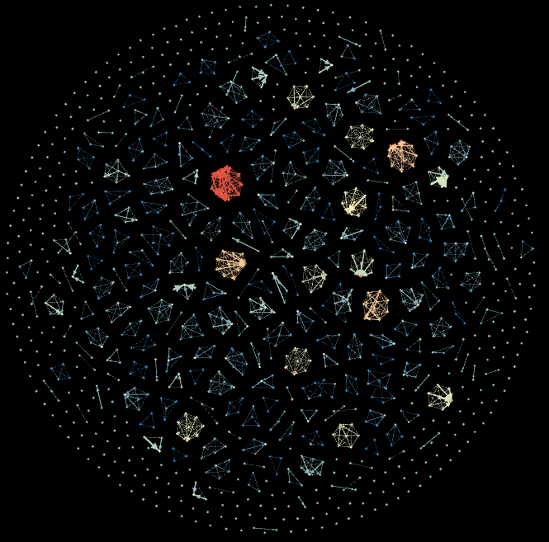
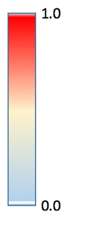
Use Case: Netflow from Edge of Network
k-Nearest Neighbor anomaly detection on graph projection features highlighted the single client in the largest community that made communication with a particular DNS server an anomalous number of times.
Client Graph Projection colored by anomaly score
Explainable features highlight most anomalous client
Client-Server DNS Graph

Slide 16
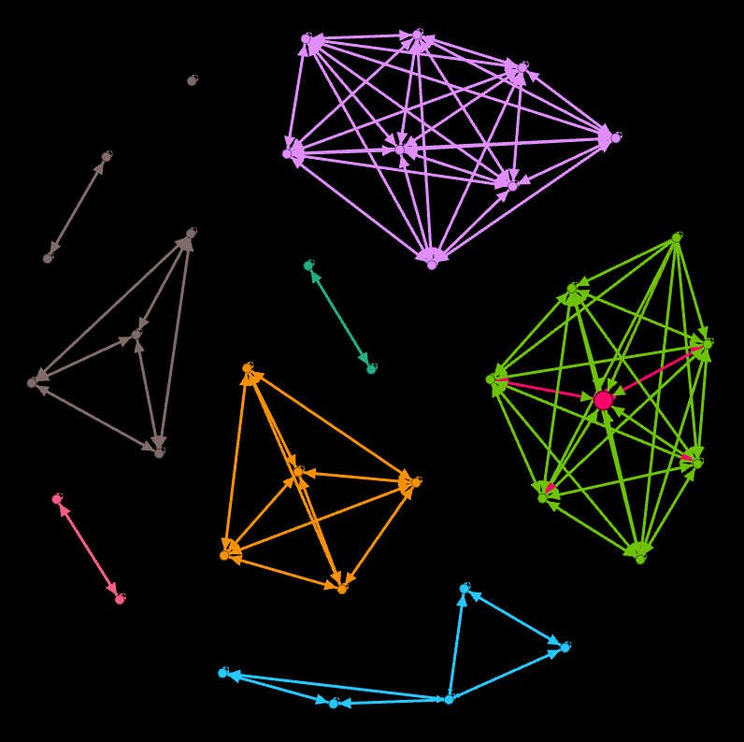



Use Case: RDP Logs
Graph projections onto username from Remote Desktop Protocol (RDP) logs highlights that communities of users that login from the same IP have multiple aliases.
Single user identified within a community with an alias of no resemblance to other users.
SourceIP 1
SourceIP 2
{jsmith, johns, johnsmith, …, adamb}
Bipartite graph: username → source ip

Slide 17
Conclusions and Next Steps
Conclusions
A novel method to capture and represent similarity between network entities
A scalable method to compute directional graph projections for enterprise scale networks
A method to rapidly visualize, identify, and interpret anomalies from cyber logs using graph features
Next Steps:
Identify more relevant and concrete cyber use cases for improvements and expansions on various similarity metrics and graph features.
We would like to extend our work to better account for temporally evolving graphs to identify significant events that occur on a network at a particular time.

